Slide 1
Safer school crossing
Lytchett matravers primary

Slide 2
Introductions
Karen and Vicky, parents of children at Lytchett Matravers Primary school and residents of the village
We are here to gain support for a safe crossing for local children to get to and from school
Notes:
Karen

Slide 3
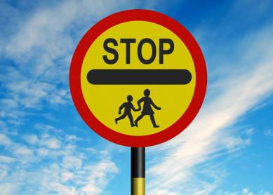
We currently have no crossing patrol
This position has been vacant for over 18 months
Past patrol persons have left due to safety concerns
These roles are very difficult to fill and not necessarily a permanent solution
Notes:
Vicky

Slide 4
The issues
Access | Parking | Driving
No dedicated safe place for children to cross the main road to school Little upkeep of hedgerows and verges on pavements | No management of parking restrictions Inconsiderate parking Lack of designated parking area for parents/carers | Dangerous driving Large uneccessary lorries driving through village Large volume of traffic
Notes:
Karen

Slide 5
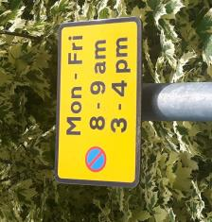
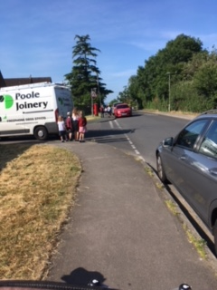
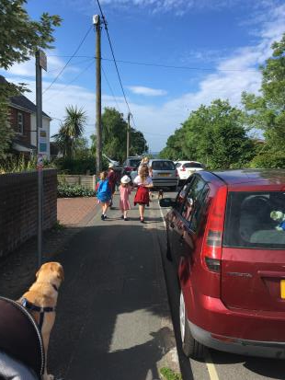
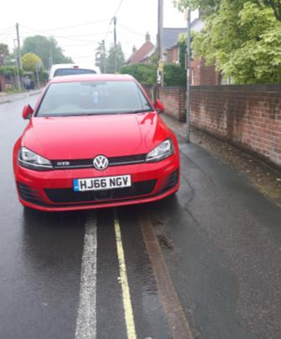
25% child pedestrian fatalities are caused by road crossings masked by stationary or parked vehicles.
Notes:
Karen

Slide 6
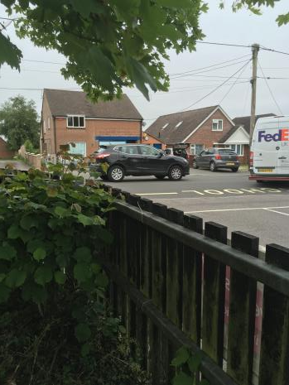
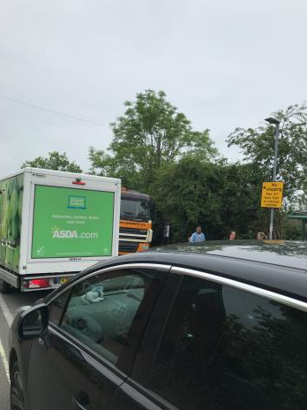
Each year, 5,000 children under 16 are seriously injured or die on Britain’s roads.
The incident rate for children peaks between 8 am and 9 am, when they are travelling to school, and again at 3 pm when they are on their way home.
Notes:
Vicky

Slide 7
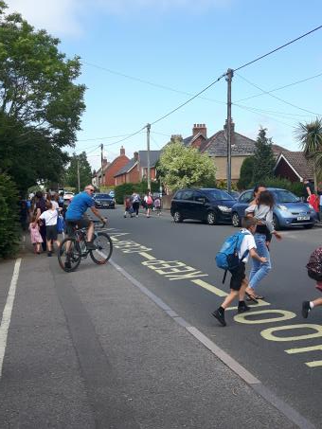
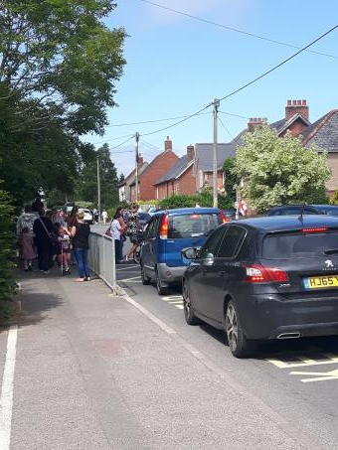
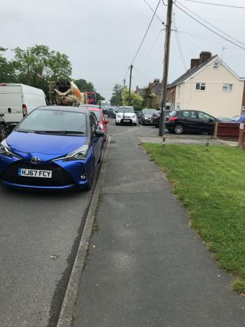
Notes:
Vicky

Slide 8
What are the parents doing?
We have over 600 signatures on the petition, showing over whelming support for this project
Parents and residents have shown strong support through comments and suggestions for a safe crossing for our children
A well supported walking bus was in place for a while but had to be discontinued on safety grounds
Parents have submitted lots of photos and shared stories of their dangerous journeys to school
Notes:
Karen

Slide 9
What are the school doing to help?
Actively advertising the crossing patrol role at the school
Regular communication to remind all parents to park considerately and not use the school car park as its dangerous
Staff often challenge parents for dangerous parking
Mr France (the head teacher) has written to the director of childrens services with his concerns
The school are keen to work with the council to get a safe crossing
Notes:
Vicky

Slide 10
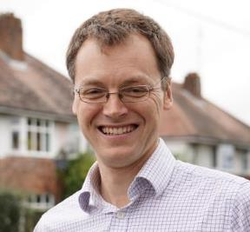
Other support
MP Michael Tomlinson is supporting the issue and wrote to all residents of Lytchett Matravers asking them to sign the petition
The Dorset Echo published an article about the importance of this project
Current government initiative to encourage children to walk to school
Notes:
Karen

Slide 11
Next steps
Present the petition to the Dorset County council petitions panel
Set-up a working group with key representatives from the community to get an action plan in place
Notes:
Vicky

Slide 12
Solution
2011-2020 is the United Nations decade of action for road safety
In Great Britain pedestrian injury is the leading cause of accidental death among children.
A permanent dedicated safe crossing outside the school
A review of parking restrictions around the school and better regulation
A review of traffic flow and volume on Wareham road
Notes:
Karen

Slide 13
Thanks for your time

